Slide 1
Reputation Based Scheme to enforce Cooperation in Wireless Ad-hoc Networks
Carryoles Maria
Liang Huo
Mani Prashanth Varma Manthena
Dr. Ertan Onur
Kishor Chandra Joshi

Slide 2

Introduction
Virtual Currency Schemes
Reputation Based Schemes
2

Slide 3
Reputation Based Scheme
Global Reputation
Local Reputation

Slide 4
Agenda
Related Work
Problem Statement
  Assumptions
  Constraints
Our Approach
  Results
Conclusion

Slide 5
Related Work
CONFIDANT
  Based on DSR
  Uses Global Reputation
CORE
  Global Reputation
OCEAN
  Based on DSR
  Uses local reputation

Slide 6
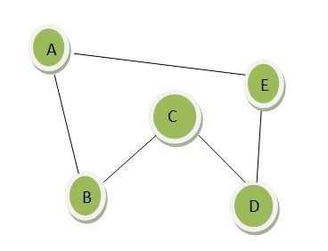
Problem Statement
“Once your problem is clearly defined, your job is half done.”

Slide 7
Problem Statement
To state:
What problems do we need to solve
What assumptions do we have to make
What constraints do we have

Slide 8

Reputation Value
R(A,B) is the rep. value of B in A’s rep. table
Rep. Table of A
Node ID | Rep. Value
B | 0.85
C | 0.60
D | 0.28
E | 0.52

Slide 9
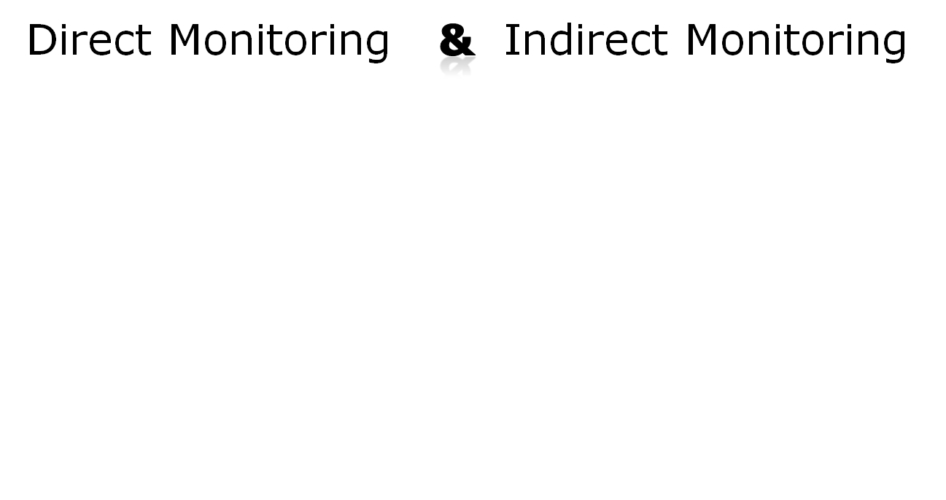
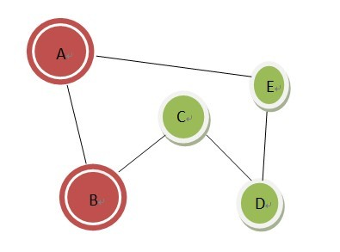
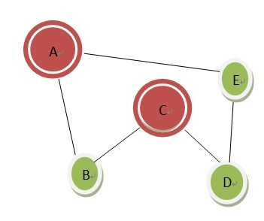

Reputation Collection

Slide 10
Inspire good behavior
Selfish node Isolated temporarily
Behave cooperatively
Still selfish
Isolated permanently
Better Network Performance

Slide 11
Other Problems
Preventing liars to transmit fake Rep. values
Reputation propagation and agreement
Detecting a selfish node

Slide 12
Problem Statement
To state:
What problems do we need to solve
What assumptions do we have to make
What constraints do we have

Slide 13
Assumptions I
Well Connected , at least 1 neighbor
“Neighbor” is 1-hop away
Rep. value between 0~1
Rep. value increases when a node cooperate, decreases when it does not

Slide 14
Assumption II
Cooperation = Relaying packets
Level of cooperation is defined only on the action of dropping packets, regardless of intentional or unintentional selfish behavior
Rep. table is updated and propagated proactively

Slide 15
Problem Statement
To state:
What problems do we need to solve
What assumptions do we have to make
What constraints do we have

Slide 16
Constraints I
Dynamic topology, nodes come and go, difficult to keep track of rep. values
Reputation propagation leads to congestion& large overhead
Different QoS requirements (packet loss, etc)

Slide 17
Constraints II
Other reasons to drop packets, e.g. physical collision, faulty nodes with no resources
Security issues

Slide 18
Our Approach
Reputation based algorithm :
Reputation monitoring and calculations
Detecting and handling liars
Reputation propagation
Reputation agreement
Handling selfish nodes

Slide 19
Reputation Mechanism
Network Initialization
Creating and initializing reputation tables for each node
e.g. Node A’s Reputation table
Node Id | Rep. Value
B | 1.00
C | 1.00
D | 1.00
E | 1.00

Slide 20
Reputation Monitoring and Calculations
Direct monitoring
Reputation calculation

Slide 21
Updating reputation table and flooding it in the network
e.g. Direct reputation monitoring of Node A on node B gives say 0.50. Then Node A’s reputation table looks as shown below
Node Id | Rep. Value
B | 0.50
C | 1.00
D | 1.00
E | 1.00

Slide 22
Indirect Monitoring
Handling liars
- Liar test

Slide 23

If a node passes the liar test i.e.
Its reputation table is used in indirect monitoring
Reputation calculations for indirect monitoring R’(A,B)=R’(C,B)=(R(A,B)+R(C,B))/2
Reputation tables are updated and flooded in the network

Slide 24
Reputation propagation and agreement
All the nodes have same reputation values for all other nodes in the network
Detecting selfish nodes
R(A,B)<0.4(Threshold)

Slide 25
Handling selfish nodes
Temporary isolation for certain time
Permanent isolation due to repeated selfish behavior

Slide 26
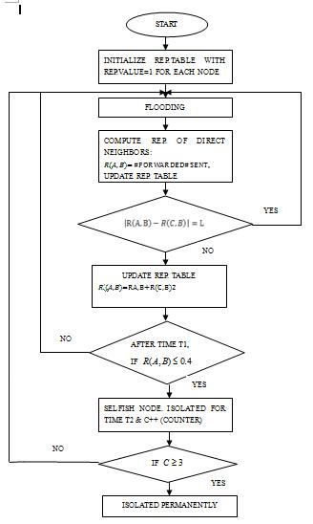
Flowchart

Slide 27
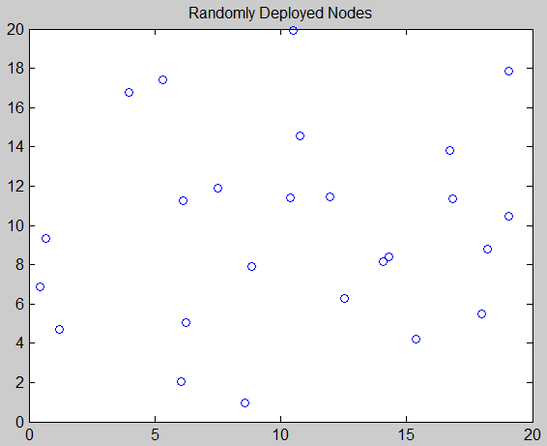
Implementation and Results
Simulation Tool – MATLAB R2012b
Random deployment of nodes in a field

Slide 28
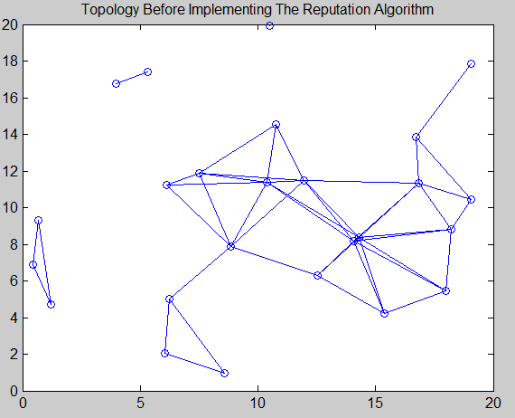
Topology based on transmission ranges of the nodes

Slide 29
Creating reputation tables for each node
Assigning random reputation values to the nodes initially
Reputation monitoring
- Direct Monitoring
- Indirect Monitoring with Liar
Test(Handling liars)

Slide 30
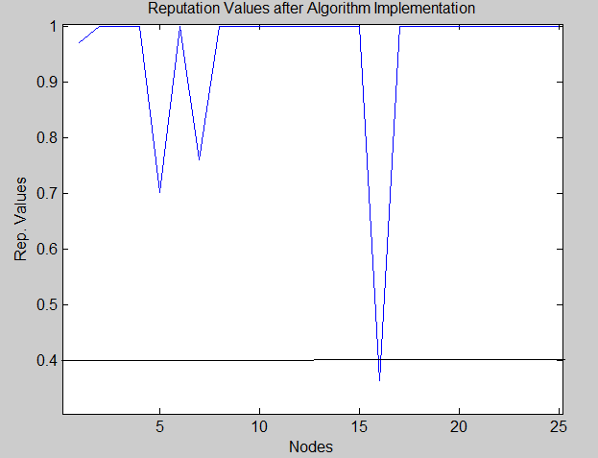
Reputation propagation and agreement
Detecting selfish nodes

Slide 31
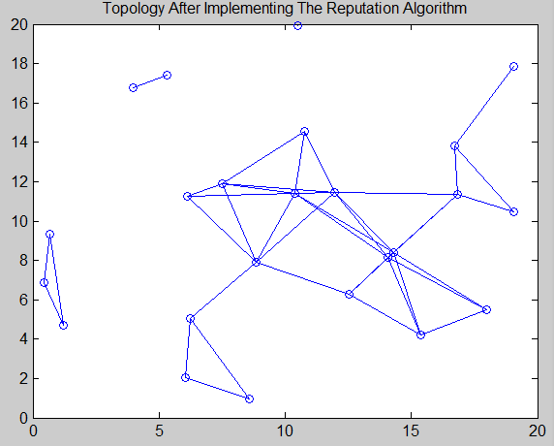
Handling selfish nodes
- Temporary isolation
- Permanent isolation

Slide 32
Algorithm implementation without deviation test i.e. Not handling liars
Two cases can be studied here
Case 1 : Selfish nodes still find a spot in the network
Case 2 : Cooperating nodes may be isolated

Slide 33
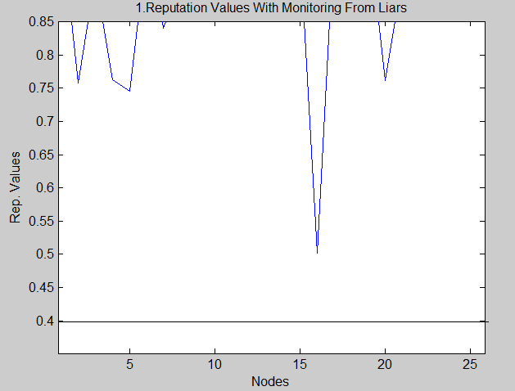
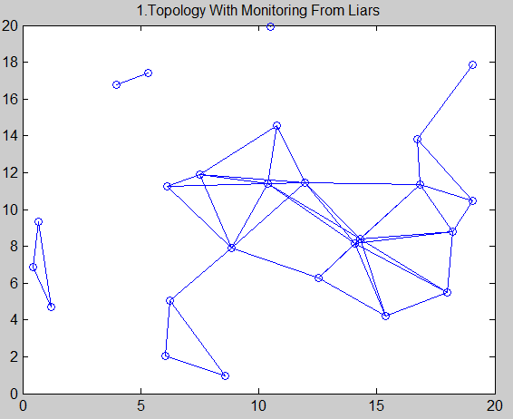
Case 1

Slide 34
Reputation algorithm with liar test i.e. Handling liars

Slide 35
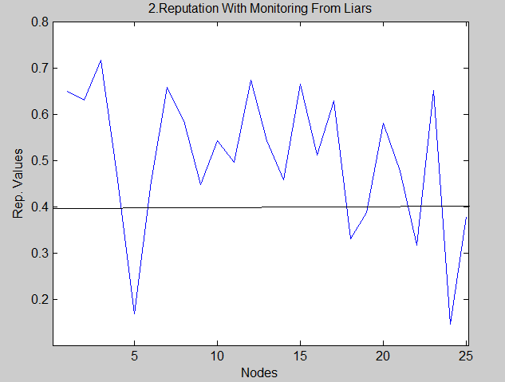
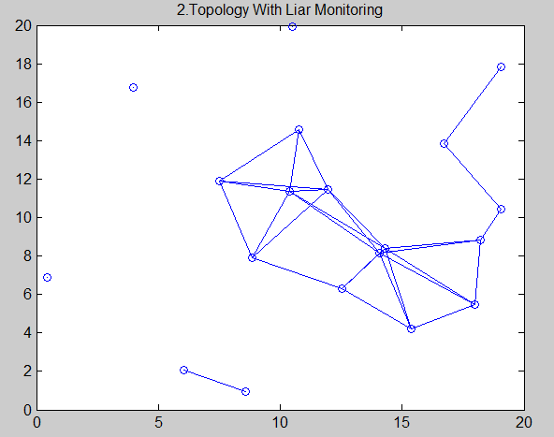
Case 2

Slide 36
Conclusion
Cooperation results in good system performance
Selfish nodes should be inspired for good behavior
Liars must be handled in reputation based algorithms

Slide 37
Future Work
We would like to measure network performance using our algorithm over a wide period of time in real world situations using a different simulation tools like OPNET or NS2
We would also like to implement security which is an important concern in ad-hoc networks

Slide 38
Thank you !!

